Slide 1
MS-606
Introduction to Management & Organizational Behavior

Slide 2
Management Functions
French industrialist Henri Fayol five management functions: planning, organizing, commanding, coordinating, and controlling
Stephen Robbins condensed these to four:
  planning,
  organizing,
  leading, and
  controlling.

Slide 3
Management Roles
In the late 1960s, Henry Mintzberg, concluded that managers perform 3 roles
(1) interpersonal
(2) informational
(3) decisional

Slide 4
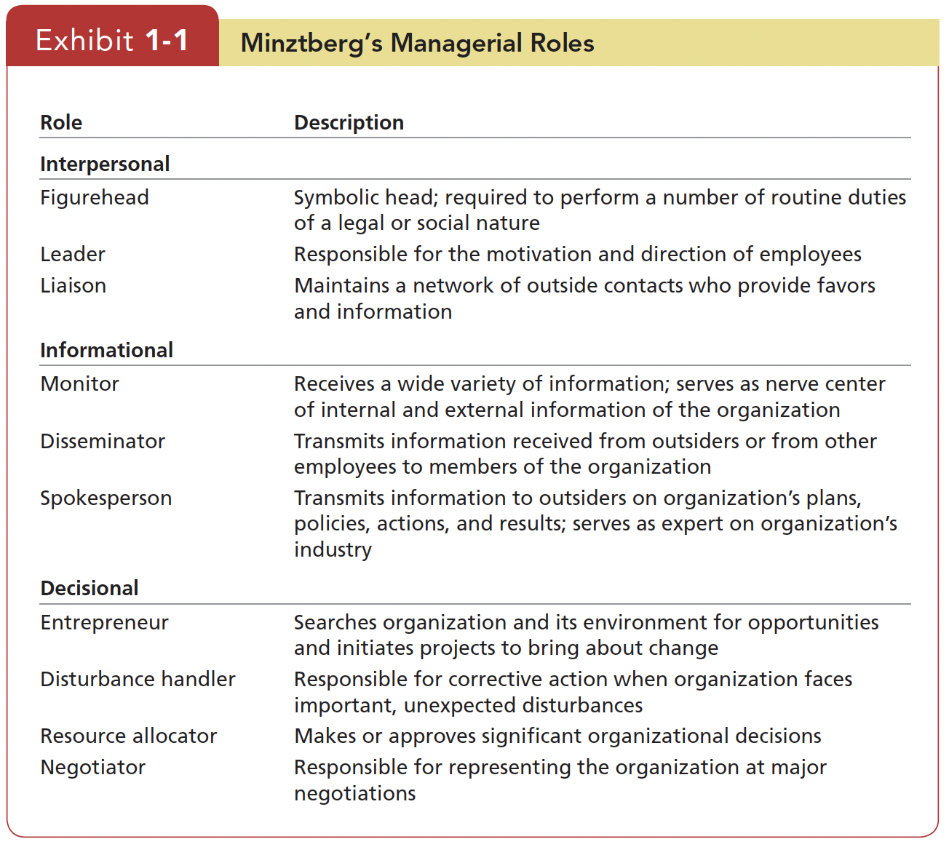

Slide 5
Management Skills
Technical Skills
Human Skills
Conceptual Skills

Slide 6
Managerial Activities
Fred Luthans studied four managerial activities
1. Traditional management. Decision making, planning, and controlling.
2. Communication. Exchanging routine information and processing paperwork.
3. Human resource management. Motivating, disciplining, managing conflict, staffing, and training.
4. Networking. Socializing, political activity, and interacting with outsiders.

Slide 7
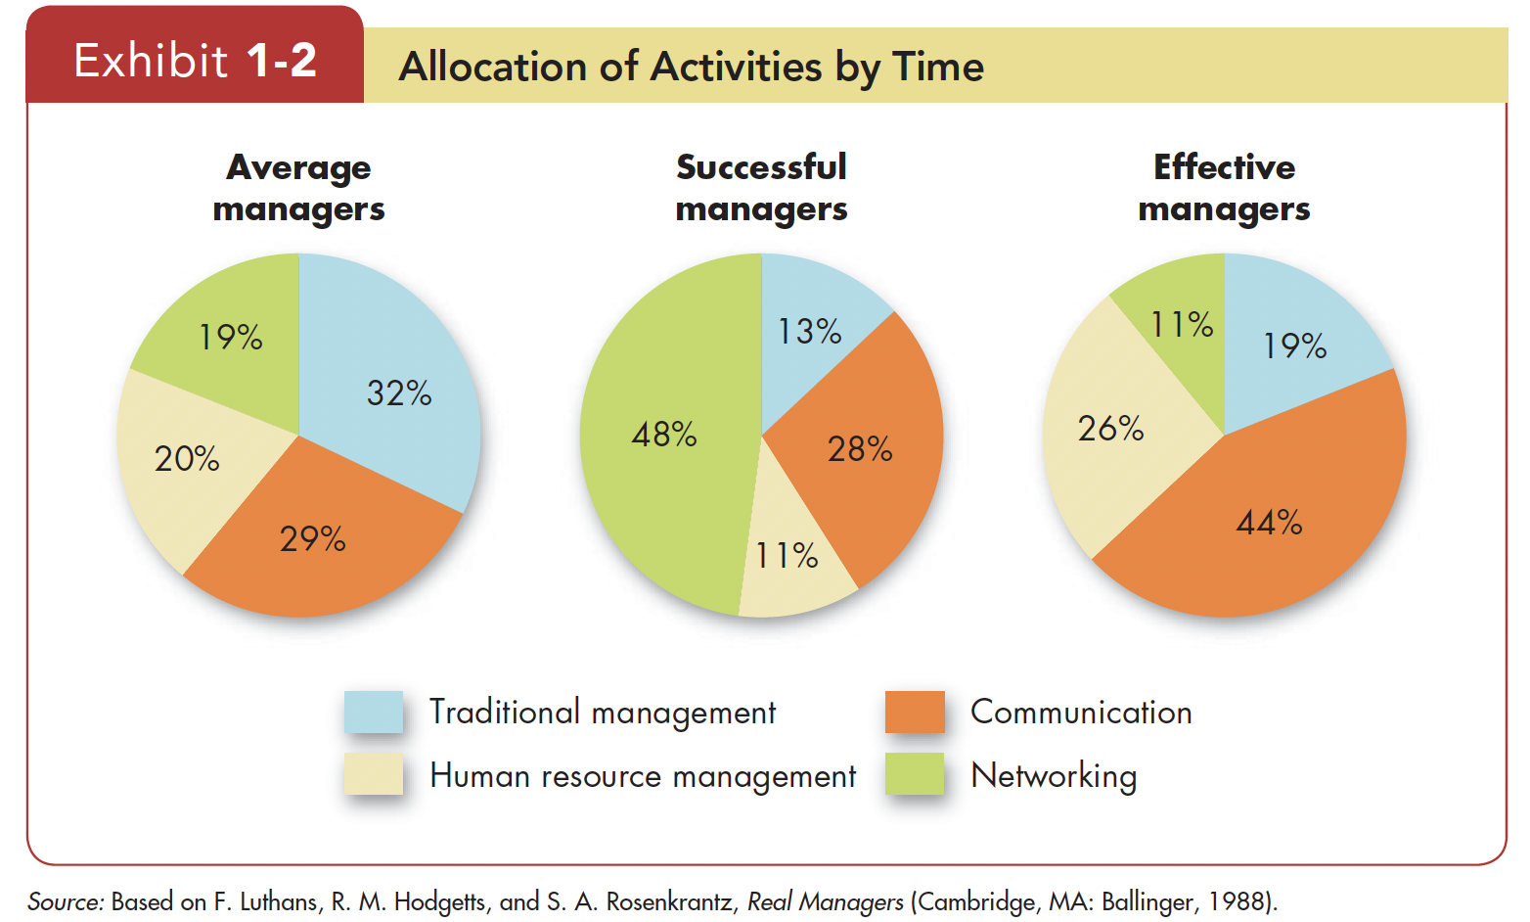
successful managers (defined in terms of speed of promotion within their organization)
effective managers (defined in terms of quantity and quality of their performance and the satisfaction and commitment of employees)

Slide 8
What is Organizational Behavior?
Organizational behavior (often abbreviated OB) is a field of study that investigates the impact that individuals, groups, and structure have on behavior within organizations, for the purpose of applying such knowledge toward improving an organization’s effectiveness (Stephen P. Robbins, Timothy A. Judge)
It studies three determinants of behavior in organizations: individuals, groups, and structure.
OB applies the knowledge gained about individuals, groups, and the effect of structure on behavior in order to make organizations work more effectively
OB is the study of what people do in an organization and how their behavior affects the organization’s performance.

Slide 9
Disciplines that Contribute to the OB Field

Slide 10
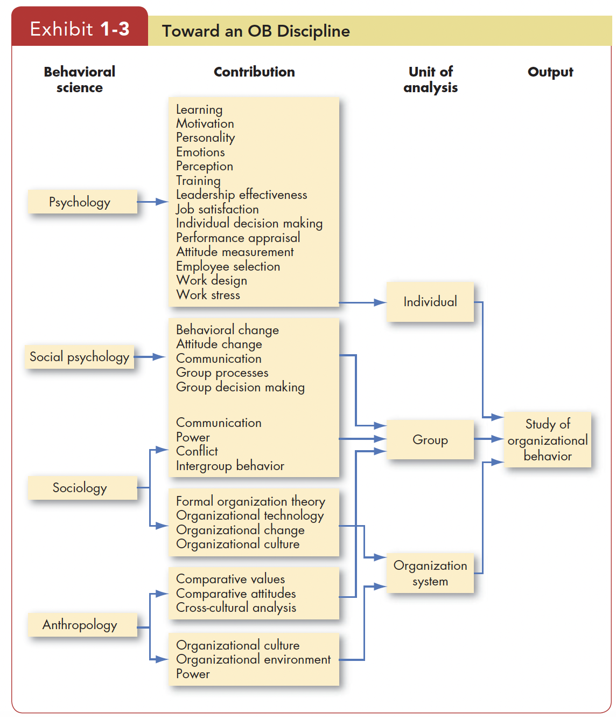

Slide 11
Disciplines That Contribute to the OB Field
Psychology’s contributions have been mainly at the individual or micro level of analysis
Psychology seeks to measure, explain, and sometimes change the behavior of humans.
Social psychology , generally considered a branch of psychology, blends concepts from both psychology and sociology to focus on peoples’ influence on one another.

Slide 12
Disciplines That Contribute to the OB Field
Sociology studies people in relation to their social environment or culture.
Sociologists have contributed to OB through their study of group behavior in organizations
Anthropology is the study of societies to learn about human beings and their activities.
Anthropologists’ work on cultures and environments has helped us understand differences in fundamental values, attitudes, and behavior between people in different countries and within different organizations.

Slide 13
Challenges and Opportunities for OB
Responding to Economic Pressures
Responding to Globalization
  Increased Foreign Assignments
  Working with People from Different Cultures
  Overseeing Movement of Jobs to Countries with Low-Cost Labor
Managing Workforce Diversity
Improving Customer Service
Improving People Skills
Stimulating Innovation and Change
Working in Networked Organizations
Helping Employees Balance Work–Life Conflicts
Creating a Positive Work Environment
Improving Ethical Behavior

Slide 14
Developing an OB model

Slide 15
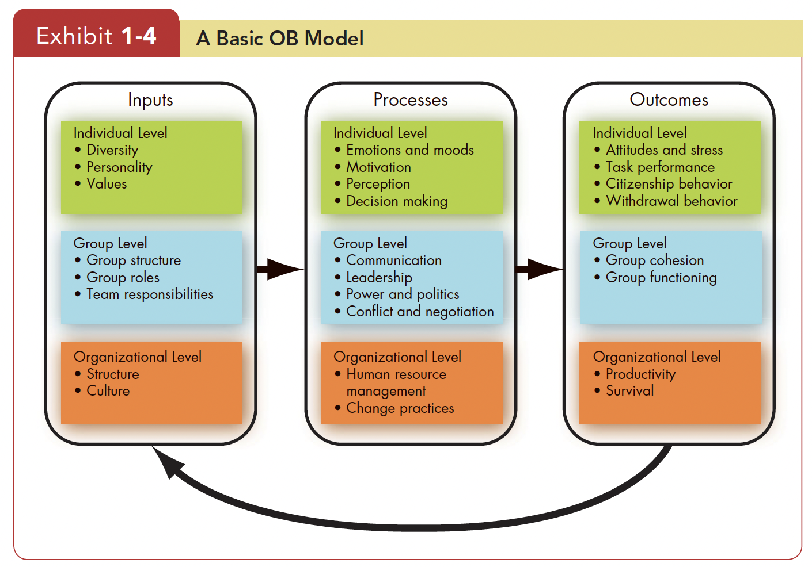

Slide 16
Developing an OB Model
Attitudes are the evaluations employees make, ranging from positive to negative, about objects, people, or events. For example, “I really think my job is great”
Stress is an unpleasant psychological process that occurs in response to environmental pressures.
Task Performance the combination of effectiveness and efficiency at doing your core job tasks.

Slide 17
Developing an OB Model
Citizenship Behavior: The discretionary behavior that is not part of an employee’s formal job requirements, and that contributes to the psychological and social environment of the workplace.
Performance beyond expectations.
Withdrawal behavior The set of actions employee take to separate themselves from the organization.
Performance below expectations.

Slide 18
Developing an OB Model
Group cohesion The extent to which members of a group support and validate one another while at work.
Group functioning The quantity and quality of a work group’s output.
Productivity The combination of the effectiveness and efficiency of an organization.
Organizational survival The degree to which an organization is able to exist and grow over the long term.

Slide 19
Diversity levels in Organizations
Surface-level diversity Differences in easily perceived characteristics, such as gender, race, ethnicity, age, or disability, that do not necessarily reflect the ways people think or feel but that may activate certain stereotypes.
Deep-level diversity Differences in values, personality, and work preferences that become progressively more important for determining similarity as people get to know one another better.
Discrimination means making judgments about individuals based on stereotypes regarding their demographic group.

Slide 20
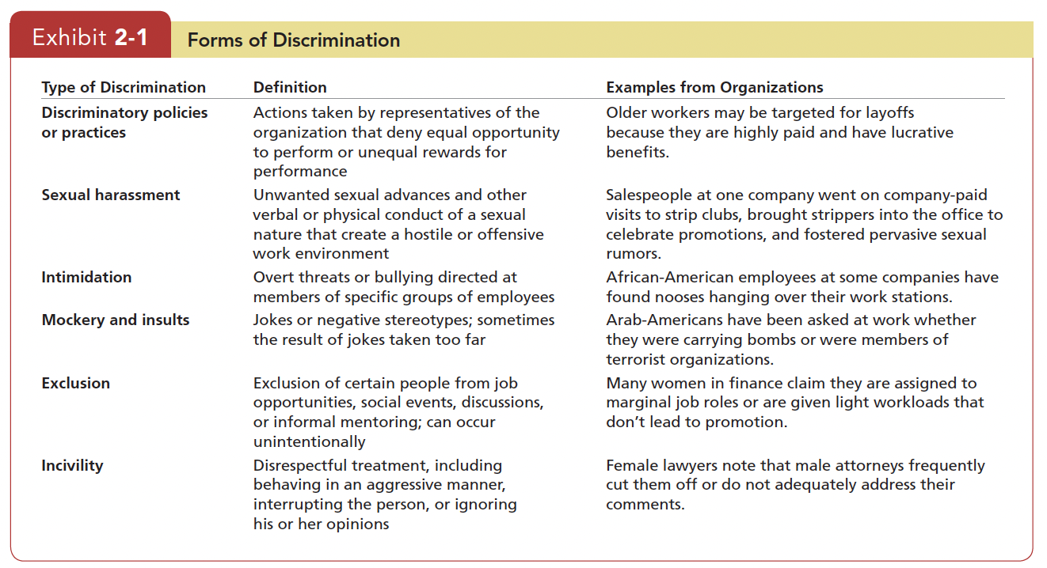

Slide 21
Biographical Characteristics
Personal characteristics that are objective and easily obtained from personnel records.
Age: relationship between age and job performance; relationship between age and job satisfaction
Gender: differences between men and women job performance, workplace behavior, work schedules, turnover rates
Race and ethnicity: People find interacting with other racial groups uncomfortable unless there are clear behavioral scripts to guide their behavior
Affect hiring decisions, performance evaluations, pay, and workplace discrimination
Ethnic discrimination leads to negative workplace outcomes

Slide 22
Biographical Characteristics
Disability: Employers are required to make accommodations so their workplaces will be accessible to individuals with physical or mental disabilities
Impact on performance outcome and evaluation
Tenure: expressed as work experience, appears to be a good predictor of employee productivity, as there is a positive relationship between seniority and job productivity
Religion: Employees of different religious faiths may conflict
Sexual Orientation and Gender Identity: Many organizations have implemented policies protecting employees on the basis of sexual orientation
Companies are putting in place policies to govern how their organization treats transgender employees

Slide 23
Ability
Ability is an individual’s capacity to perform the various tasks in a job.
Intellectual abilities The capacity to do mental activities-thinking, reasoning, and problem solving.
General Mental Ability (GMA) An overall factor of intelligence, generalized across cultures
Physical Abilities The capacity to do tasks that demand stamina, dexterity (skill in using hands), and strength

Slide 24
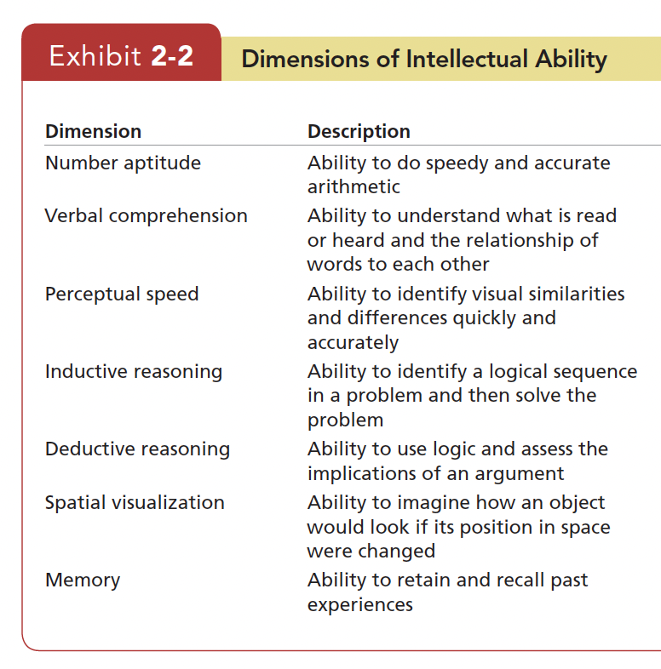

Slide 25
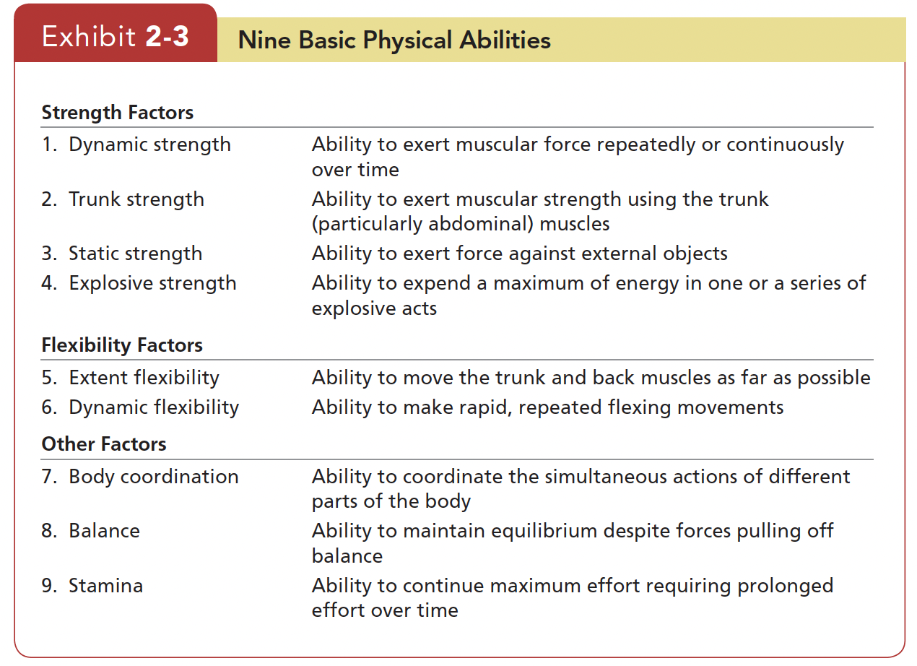

Slide 26
Diversity Management
The process and programs by which managers make everyone more aware of and sensitive to the needs and differences of others.
Attracting: Target recruiting messages to specific demographic groups underrepresented in the workforce
Selecting: Qualifications are far more important in determining who gets hired than demographic characteristics
Developing: Those whose personality traits are similar to those of their co-workers and supervisors are more likely to be promoted
Retaining: a positive diversity climate was related to higher organizational commitment and lower turnover intentions

Slide 27
Diversity in Groups
Demographic diversity does not increase or decrease team performance.
Teams of individuals who are highly intelligent are more effective. Thus diversity on these variables is likely to decrease team performance.
Groups of diverse individuals will be much more effective if leaders can show how members have a common interest in the group’s success

Slide 28
Effective Diversity Programs
First, they teach managers about the legal framework for equal employment opportunity and encourage fair treatment of all people regardless of their demographic characteristics.
Second, they teach managers how a diverse workforce will be better able to serve a diverse market of customers and clients.
Third, they foster personal development practices that bring out the skills and abilities of all workers

